Slide 1

Getting F-Bounded Polymorphism into Shape
Ben Greenman, Fabian Muehlboeck, and Ross Tate
Cornell University
Notes:
(4) 1:00

Slide 2
Notes:
(3) 1:00

Slide 3
Typesafe Equality + Generic Lists?
Notes:
(2) 1:00

Slide 4

(Typesafe) Equality
@override
public boolean equals(Object other) {
if(other instanceof String){…}
else { return false; }
}
“Hello”.equals(5)
Notes:
(1) 1:00
Object.equals lets you compare “hello” with 4

Slide 5

(Typesafe) Equality
interface Eq<T> {
boolean equalTo(T other);
}
class String extends Eq<String> {
boolean equalTo(String other) {…}
…
}
“Hello”.equalTo(5)
Notes:
1:00

Slide 6
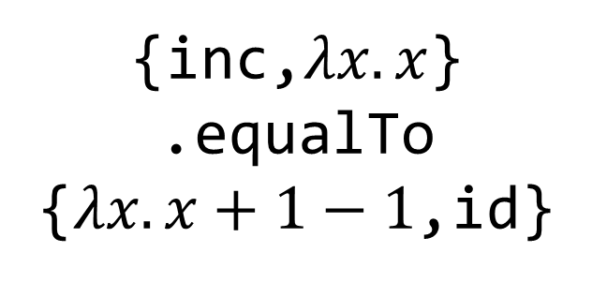
(Typesafe) Equality
{“Hello”,”World!”}
.equalTo
{“Ahoi”,”World!”}
{inc,$λx.x$}
.equalTo
{$λx.x+1−1$,id}
Notes:
(3) 3:10

Slide 7
List (read-only)
Eq
covariant
contravariant
List<out T>
Eq<in T>
List<String>
List<Object>
Eq<Object>
Eq<String>
:>
:>
Notes:
(2) 3:10 conceptually

Slide 8
interface List<out T>
extends
Eq<List<Eq<T>>>
Notes:
(1) 3:10

Slide 9
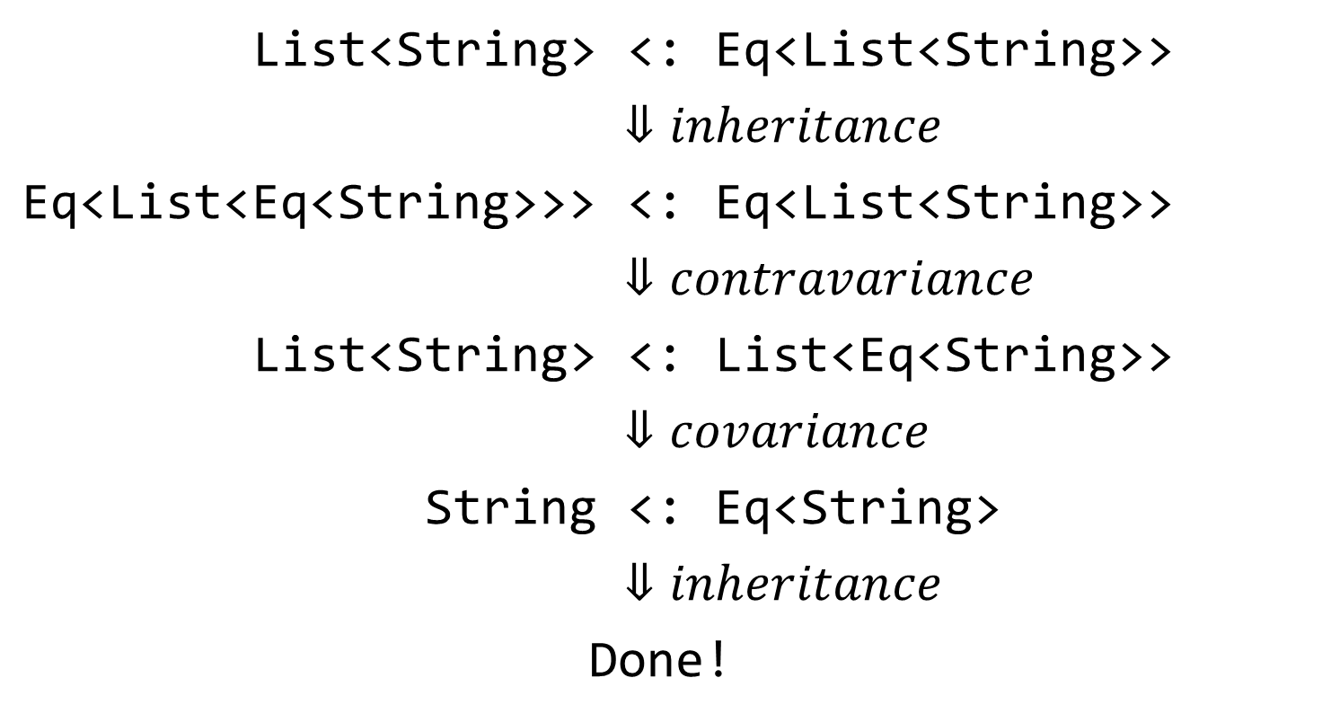
interface List<out T>
extends Eq<List<Eq<T>>>
List<String> | <: | Eq<List<String>>
 | $$⇓inheritance$$
Eq<List<Eq<String>>> | <: | Eq<List<String>>
 | $$⇓contravariance$$
List<String> | <: | List<Eq<String>>
 | $$⇓covariance$$
String | <: | Eq<String>
 | $$⇓inheritance$$
Done!
Eq<List<Eq<String>>>
Eq<List<String>>
List<String>
List<Eq<String>>
List<String>
List<Eq<String>>
String
Eq<String>
Notes:
3:10

Slide 10
Ross Tate, Alan Leung, and Sorin Lerner
Taming Wildcards in Java's Type System , PLDI 2011
Andrew J. Kennedy and Benjamin C. Pierce
On Decidability of Nominal Subtyping with Variance, FOOL-WOOD 2007
List<T> extends Eq<List<Eq<T>>>
List<T> extends Eq<List<Eq<T>>>
List<T> extends Eq<List<Eq<T>>>
Nested Contravariance!
List<T> extends Eq<List<Eq<T>>>
List<T>
List<Eq<T>>
Expansive Inheritance!
Notes:
4:00
Eq<List<Eq<T>>>
List<Eq<T>> extends Eq<List<Eq<Eq<T>>>
List<Eq<Eq<T>>> extends Eq<List<Eq<Eq<Eq<T>>>>>

Slide 11
Trees
class Tree extends List<Tree>
Are trees equatable?
Notes:
(2) 5:30 Lets ask visual studio

Slide 12
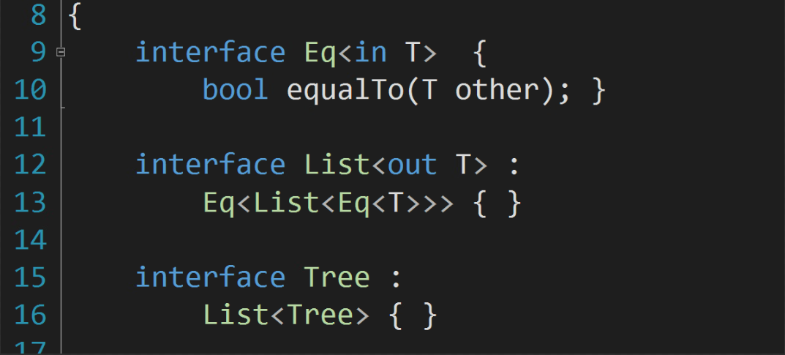
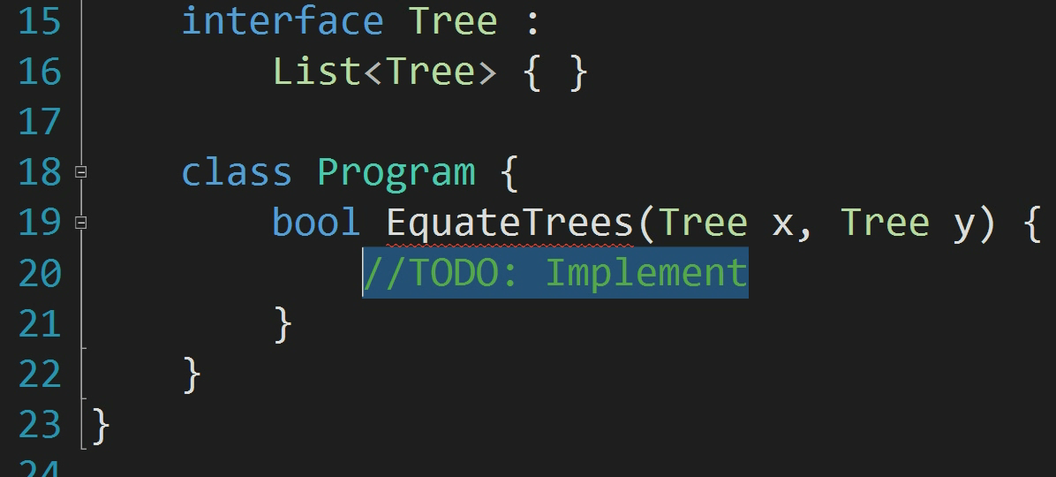
Are Trees equatable?
Notes:
(1) 5:30

Slide 13
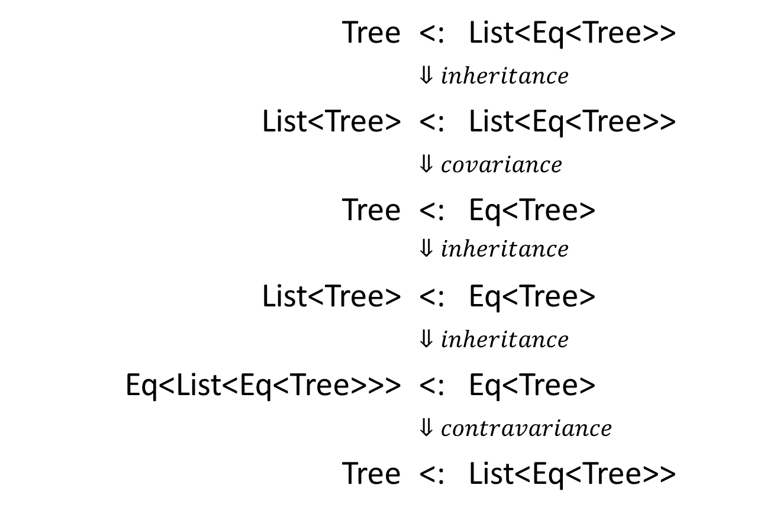
Are Trees equatable?
Tree | <: | List<Eq<Tree>>
 | $$⇓inheritance$$
List<Tree> | <: | List<Eq<Tree>>
 | $$⇓covariance$$
Tree | <: | Eq<Tree>
 | $$⇓inheritance$$
List<Tree> | <: | Eq<Tree>
 | $$⇓inheritance$$
Eq<List<Eq<Tree>>> | <: | Eq<Tree>
 | $$⇓contravariance$$
Tree | <: | List<Eq<Tree>>
List<Tree>
List<Eq<Tree>>
Tree
Eq<Tree>
Eq<List<Eq<Tree>>>
Eq<Tree>
Tree
List<Eq<Tree>>
Notes:
5:30

Slide 14
Meh!
Notes:
(2) 6:00
Corner-case

Slide 15
interface List<out T>
extends
Eq<List<Eq<T>>>
Notes:
(1) 6:00

Slide 16
Notes:
6:00

Slide 17
WHY?
Notes:
(2) 7:30

Slide 18
interface List<out T>
extends
Eq<List<Eq<T>>>
List<Eq<T>>
Notes:
(1) 7:30

Slide 19
How do we use Eq<…>?
List<String>
NOT as type arguments!
List<Eq<…>>
With F-bounded polymorphism!
NOT for parameters!
class String extends Eq<String>
class Set<T extends Eq<T>>
NOT for return types!
NOT for fields!
NOT for local variables!
Notes:
7:30
Mention Self-types
So in a nutshell: Lists of, for example, strings are ok, but lists of Eq are not. Why is that?

Slide 20
Shapes
Materials
Used in
Recursive inheritance definitions
Recursive type variable constraints
Used for
Type arguments
Method parameters
Return types
Fields
Variables
Eq<T>
Comparable<T>
Clonable<T>
Summable<T>
String
List<T>
Throwable
FileStream
Notes:
8:30
In summary, there is a split (click) between things that : (click)
….
At least, according to our industry friends, who might be an exception.

Slide 21
All Sheep in Scotland are black
Notes:
(5) 9:00

Slide 22
Read these 13 million lines of Code!
Can I script it?
NO!
I mean… YES!
Notes:
(4) 9:00

Slide 23
Survey
13.5 million lines of open-source generic Java code
from 60 projects
taken primarily from the Qualitas Corpus*
No class was ever both a shape and a material
- Type arguments
- Method parameters
- Return types
- Fields & Variables
Recursive
- inheritance definitions
- type variable constraints
*http://qualitascorpus.com
Notes:
(3) 9:00 No class OR interface

Slide 24
Material-Shape Separation
Thou shalt not
mix shapes
and materials!
Notes:
(2) 9:00

Slide 25
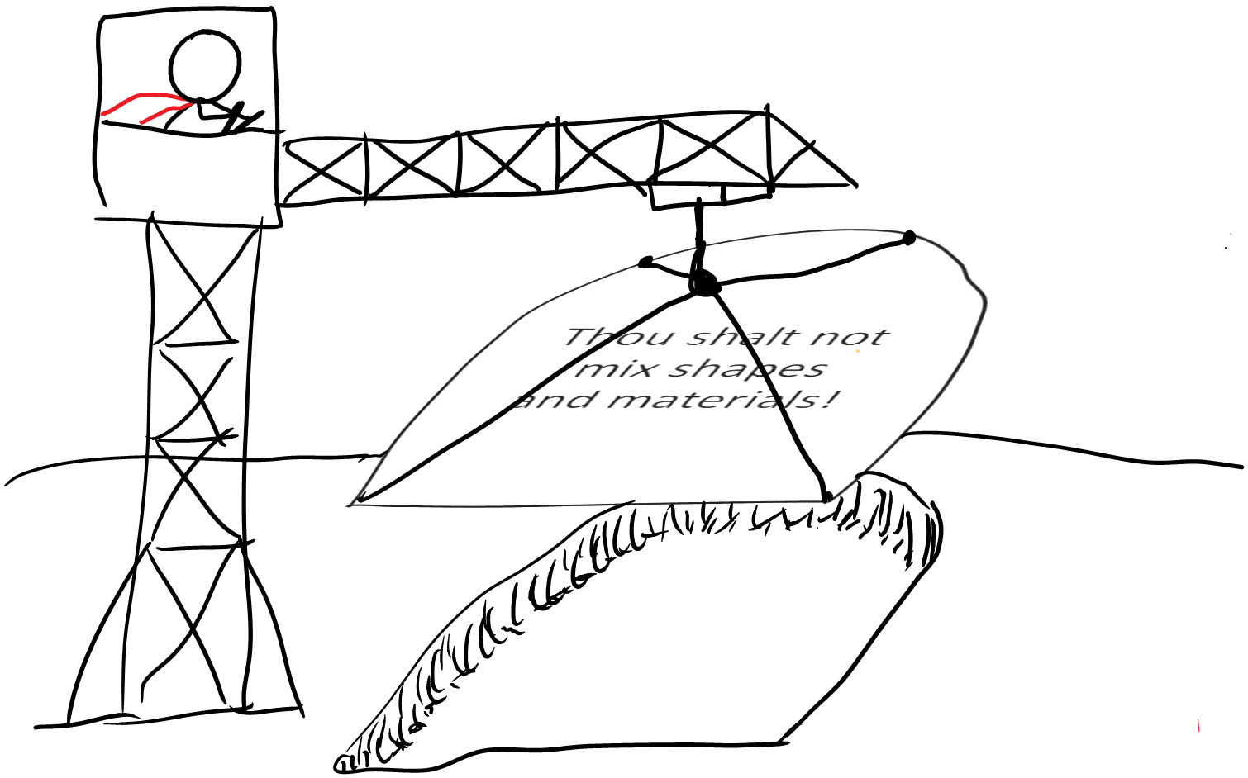
Notes:
(1) 9:00
Laying the foundation for type systems with powerful features and strong properties

Slide 26
Shapes
Materials
Used in
Recursive inheritance definitions
Recursive type variable constraints
Used for
Type arguments
Method parameters
Fields
Variables
Recursive inheritance
only through Shapes
Well-founded inheritance
Notes:
9:00
Because nothing is both a shape and material

Slide 27
Well-founded Material Inheritance
Materials
class A extends B<C>, D<E> {…}
Inheritance hierarchies defined
independent of A
Notes:
(1) 10:00
Use B, D, C, E directly

Slide 28
Well-founded Material Inheritance
class A extends B {…}
class B extends A {…}
class A extends List<B> {…}
class B extends List<A> {…}
Notes:
10:00

Slide 29
Decidable Subtyping
With naïve algorithms
Proven with a simple measure
Notes:
(2) 11:30

Slide 30
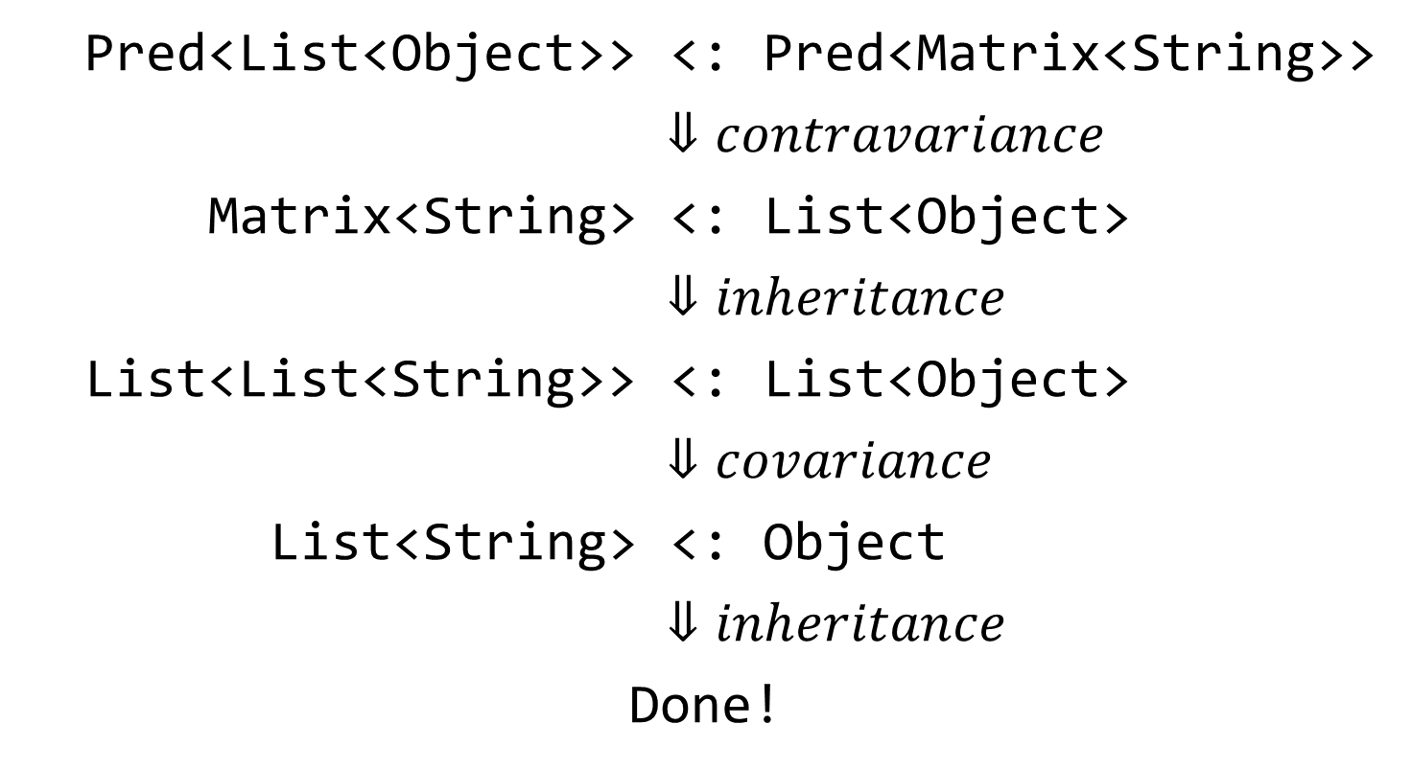
Decidable Subtyping
material interface Pred<in T>
material interface Matrix<out T>
extends List<List<T>>
Pred<List<Object>> | <: | Pred<Matrix<String>>
 | $$⇓contravariance$$
Matrix<String> | <: | List<Object>
 | $$⇓inheritance$$
List<List<String>> | <: | List<Object>
 | $$⇓covariance$$
List<String> | <: | Object
 | $$⇓inheritance$$
Done!
Notes:
(1) 11:30

Slide 31
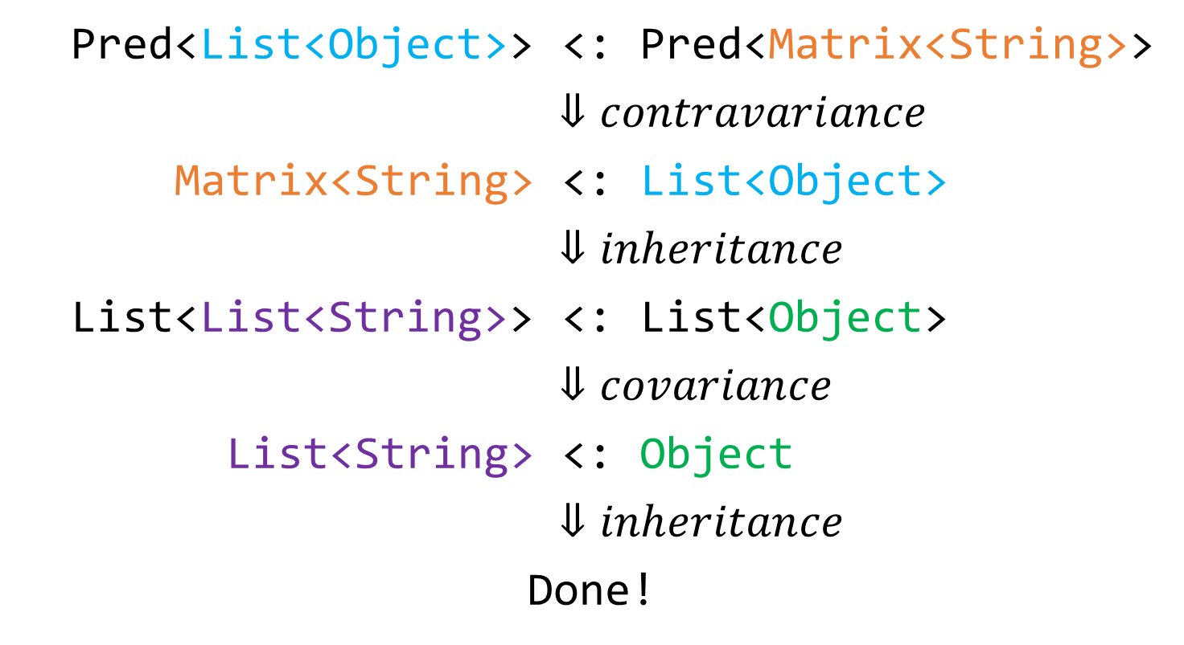
Decidable Subtyping
Pred<List<Object>> | <: | Pred<Matrix<String>>
 | $$⇓contravariance$$
Matrix<String> | <: | List<Object>
 | $$⇓inheritance$$
List<List<String>> | <: | List<Object>
 | $$⇓covariance$$
List<String> | <: | Object
 | $$⇓inheritance$$
Done!
Notes:
11:30

Slide 32
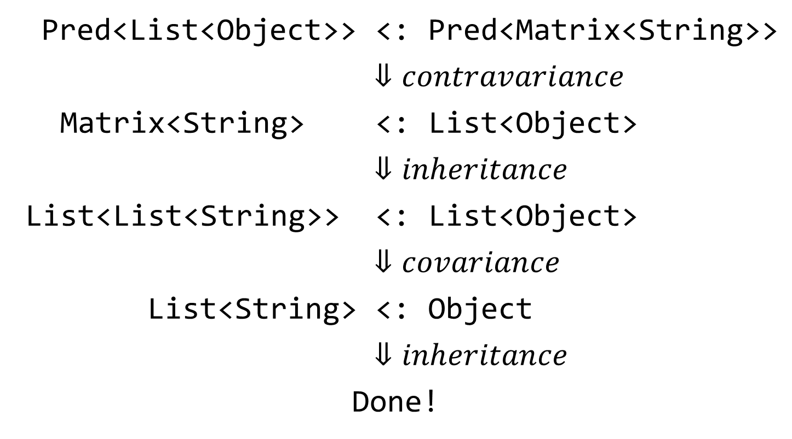
Decidable Subtyping
Pred<List<Object>> | <: | Pred<Matrix<String>>
 | $$⇓contravariance$$
Matrix<String> | <: | List<Object>
 | $$⇓inheritance$$
List<List<String>> | <: | List<Object>
 | $$⇓covariance$$
List<String> | <: | Object
 | $$⇓inheritance$$
Done!
Notes:
12:00
Expansion Potential

Slide 33
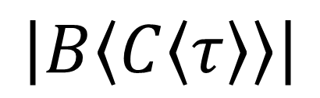
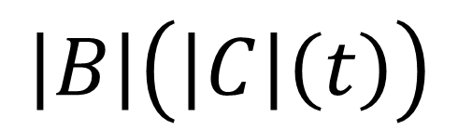
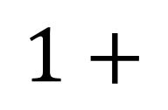
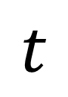
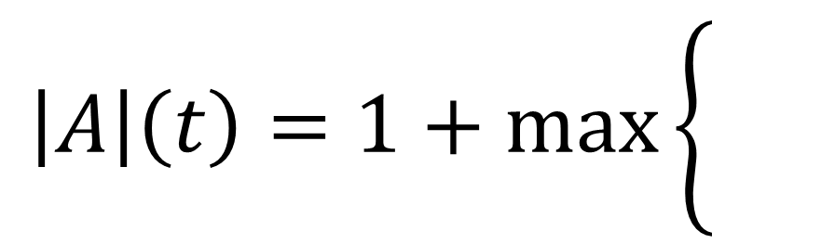
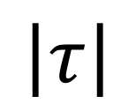

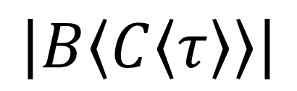
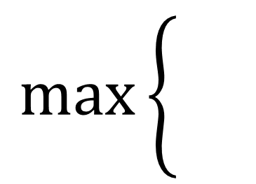
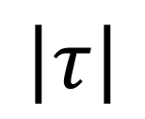
Decidable Subtyping
A<T> extends B<C<T>>
$$\max\left\{\begin{aligned} \\ \end{aligned}\right.$$
$$\left|τ\right|$$
$$\left|τ\right|$$
$$\left|A〈τ〉\right|=$$
$$1+$$
$$\left|B〈C〈τ〉〉\right|$$
$$\left|B〈C〈τ〉〉\right|$$
$$\left|A\right|\left(t\right)=1+\max\left\{\begin{aligned} \\ \end{aligned}\right.$$
$$t$$
$$\left|B\right|\left(\left|C\right|\left(t\right)\right)$$
Inheritance well-founded
➔ measure function terminates
Notes:
14:00
Just how A is a function on types, we can MAKE it a function on measures

Slide 34

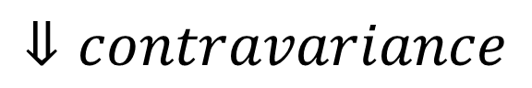

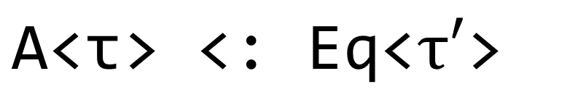
Decidable Subtyping
A<in T> extends Eq<A<List<T>>>
A<in T> extends Eq<A<List<T>>>
$$\text{A}\text{<}\text{τ}\text{> <: }\text{Eq}\text{<}τ′\text{>}$$
$$⇓^{∗}inheritance$$
No Shapes in here
$$\text{E}\text{q}\text{<}\text{A}\text{<}\text{List}\text{<}\text{τ}\text{>>> <: }\text{Eq}\text{<}τ′\text{>}$$
$$⇓contravariance$$
All Materials
$$\text{τ}\text{′}\text{ <:} \text{A}\text{<}\text{List}\text{<}\text{τ}\text{>>}$$
Notes:
15:00

Slide 35
Notes:
(1) 15:10

Slide 36
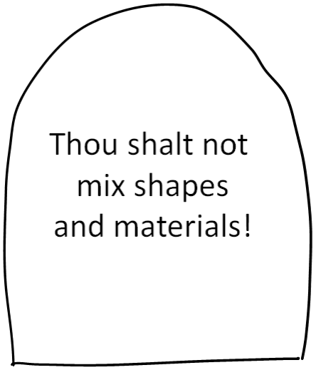
Notes:
15:10

Slide 37
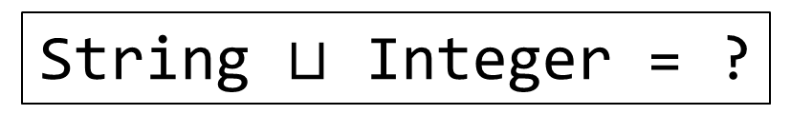
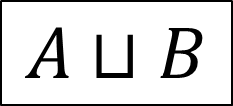
Joins
$$A⊔B$$
Most precise common supertype
String $⊔$ Integer = ?
someBool ? 42 : “Hello”
Notes:
15:30

Slide 38
Joins
Integer extends Clonable<Integer>
String extends Clonable<String>
String $⊔$ Integer = ?
Clonable<Object>
Clonable<Clonable<Object>>
Clonable<Clonable<Clonable<Object>>>
Notes:
16:30
Don’t worry about the intermediate shape types

Slide 39
Computable Material Joins
Integer extends Clonable<Integer>
String extends Clonable<String>
String $⊔$ Integer = ?
someBool ? 42 : “Hello”
Materials only: Object
Notes:
16:40

Slide 40

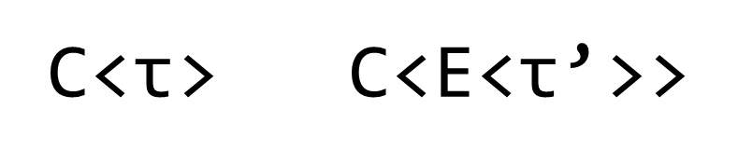
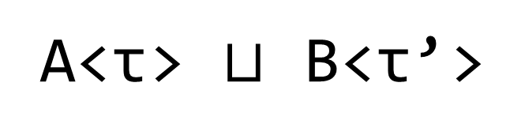

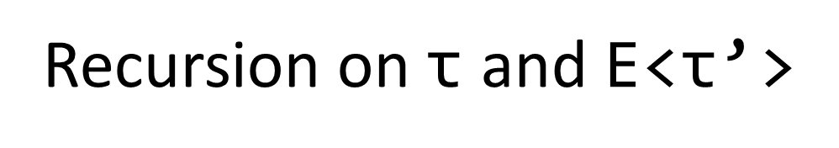
Material Joins
A<T> extends C<T>
B<T> extends C<E<T>>
A<$\text{τ}$> $⊔$ B<$\text{τ}$’>
$$⇓^{∗} { ⇓}^{∗} inheritance$$
C<$\text{τ}$> C<E<$\text{τ}$’>>
Finite due to
well-founded
material inheritance
C<…>
Recursion on $\text{τ}$ and E<$\text{τ}$’>
Recursion on $\text{τ}$ and E<$\text{τ}$’>
Notes:
17:45

Slide 41
Higher Kinds
Notes:
18:15
Higher-ORDER

Slide 42
Notes:
18:20

Slide 43

Conditional Inheritance
Notes:
19:20

Slide 44
Decidable Subtyping
Computable Joins
Higher Kinds
Material-Shape Separation
Notes:
19:40

Slide 45
Notes:
19:55 languages with powerful features and strong properties

Slide 46

Notes:
20:00

